Slide 1
Onkaam
//
api
By team …..
Coders

Slide 2
TABLE OF CONTENTS
1
Challenge Overview
5
Unique Features
2
Problem Categories
6
Key Benefits
3
Introducing Onkaam
7
Live Demo
4
Services Offered
8
Conclusion

Slide 3
Challenge Overview
Finding reliable service providers for essential tasks like Plumbing and Electrical repairs is challenging due to a lack of local knowledge and verified information. Without a dependable system for credential verification and quality assessment, users face risks like poor workmanship, financial loss, and stress.

Slide 4
Problem Categories
Difficulty in Finding Trustworthy Service Providers.
Lack of Important Local Information.
No Reliable Way to Verify Credentials.
Challenges in Judging Service Quality.
Lack of Clear Feedback and Reviews.
High Risk of Losing Money.
Disorganized and Confusing Market.

Slide 5
Here is our solution

Slide 6
Exploring Onkaam
Onkaam is an advanced application designed to efficiently connect users with reliable service providers for essential home tasks. The platform features a comprehensive directory of skilled technicians specializing in areas such as appliance repair, electrical work, plumbing, building, painting, and carpentry. By utilizing location-based services, Onkaam enables users to access detailed contact information for nearby experts, ensuring they can find the right professional no matter their location. Each technician’s profile includes key details like name, address, and contact information, allowing users to directly call and schedule appointments. Onkaam's intuitive interface and accurate data streamline the process of finding trustworthy service providers, reducing stress and enhancing user satisfaction in both familiar and new areas.

Slide 7
Services Offered
Appliance Repair Services -------
Air Conditioner
Microwave
Washing Machine
Television
Refrigerator
Geyser
Water Purifier
Home Improvement Services-----
Builders
Painters
Carpenters
Technical Repairs------
Computer Technicians
Dish tv services------
Hack way
Jio
Airtel….
House Maintenance Services------
Electricians
Plumbers

Slide 8


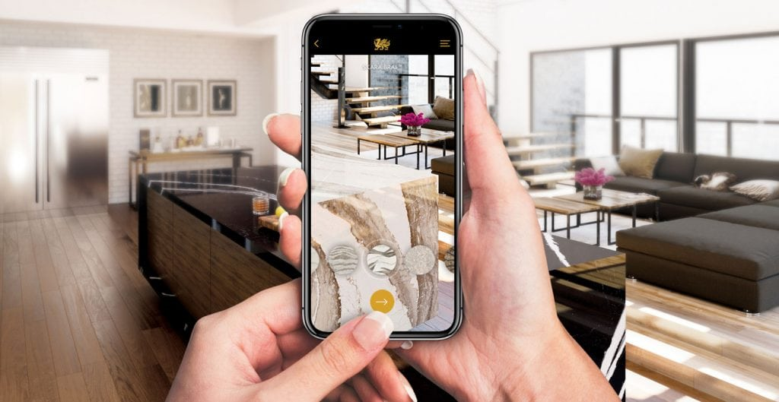
What make onkaam different
Onkaam with Builders :
Visualize renovations in your space with AR before committing to a builder, ensuring designs match your vision.
Onkaam with Carpenters :
Use AR to preview custom furniture and woodwork in your home, allowing precise design adjustments before hiring a carpenter.
Onkaam with Painters :
See how different paint colors will look on your walls in real-time with AR, helping you choose the perfect shade before painting begins.

Slide 9
Key Benefits
All-in-One Service Platform-----
Connects users with a wide variety of home and technical repair services in one place.
Skill-Based Technician Matching-----
Matches users with technicians based on their specific skills and expertise.
Verified and Reliable Technicians –------
Ensures technicians are thoroughly checked and trustworthy.
Relevant Market Pricing-------
Provides service descriptions along with relevant market prices according to the city market rate.
Enhanced Professional Visibility------
Helps technicians gain visibility and showcase their skills to attract more clients.
Innovative AR Features-----
Provides augmented reality tools for visualizing home improvements before they happen.

Slide 10
Live demo

Slide 11
Conclusion
Onkaam is transforming the way people find and hire reliable service providers. Our platform simplifies the process by connecting users with verified and trustworthy technicians for tasks like appliance repair, electrical work, plumbing, and more. Using location-based services, users can quickly access detailed contact information for nearby experts, making it easier to find the right professional for their needs. Additionally, Onkaam's innovative AR features allow users to visualize renovations, custom furniture, and paint colors in their own space before committing, ensuring the final results meet their expectations. By addressing common challenges and reducing the stress of home repairs, Onkaam provides a seamless and efficient solution for users, whether they are new to an area or seeking better management of their home maintenance needs.

Slide 12
Thank you

Slide 13
How Onkaam Differs from Others
AR Integration:
Onkaam: Offers AR for visualizing home improvements in real-time.
Others: Does not include AR features.
Skill-Based Matching:
Onkaam: Matches users with technicians based on specific skills
Others : General matching without specialized skill focus.
Seamless Service Integration:
Onkaam: Combines AR planning with direct service booking.
Others : Primarily a service booking platform.
Enhanced Professional Visibility:
Onkaam: Boosts visibility for newer, skilled technicians.
Others : Focuses on established professionals.
Employment Focus:
Onkaam: Aims to create job opportunities for underrepresented workers.
Others : Connects users with existing service providers.

Slide 14
KEY challenges we have with onkaam
User Acquisition and Retention:
Gaining enough users and keeping them engaged is critical. In a competitive market, attracting new users and ensuring they continue to use the platform can be difficult, especially when reliability and quality are key concerns
Service Provider Verification:
Ensuring that service providers are trustworthy and qualified is a challenge. Implementing a system that effectively verifies credentials and maintains quality is essential, as any lapse here can lead to user dissatisfaction and loss of trust.
Balancing Supply and Demand:
Matching the number of service providers to user demand is a common issue. Without a sufficient number of providers, users may face delays, leading to dissatisfaction, while an oversupply could result in idle providers.
Technology Maintenance and Updates:
Regular maintenance and updates are necessary to fix bugs, improve performance, and introduce new features. Ensuring that the app remains secure, especially in handling sensitive user information, is a continuous challenge.

Slide 15
Target audience
Homeowners and Renters
Property Managers
Small Business Owners
Technicians and Service Providers
Tech-Savvy Users

Slide 16
Some Cause that we recover
Enhancing Service Reliability:
Providing users with access to vetted and trustworthy service providers to ensure high-quality work and reduce the risk of poor service.
Streamlining Service Booking:
Simplifying the process of finding and booking repair and maintenance services through a user-friendly platform.
Increasing Transparency:
Offering detailed profiles of service providers, including reviews and ratings, to help users make informed decisions.
Facilitating Quick and Efficient Communication:
Enabling direct contact between users and service providers for seamless appointment scheduling and service management.

